Slide 1


Analysis of public sentiment on Twitter versus debate performance of top GOP candidates.
Dealing with Data Final Project- TEAM #2
Team Members: Ankur Chaudhary , Christina Wei, Janul Hernandez, and Peter Meijer

Slide 2

Executive Summary
Project Process
Which sources of data did we look at?
Difficulties in acquiring data.
How did we use the data.
What do the debates say?
A focused look at debate sentiment analysis per candidate through the last 3 debates of the GOP season.
As a GOP candidate has Donald Trump seen more success from negative rhetoric than his running mates?
Public Sentiment?
How is Trump trending on Twitter compared to his running mates?
Conclusion
What does the analysis and data tell us
What could we have done different?

Slide 3
Agenda
Project Process
What Do the Debates Say?
Public Sentiment
Conclusion

Slide 4


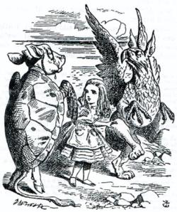

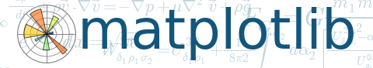


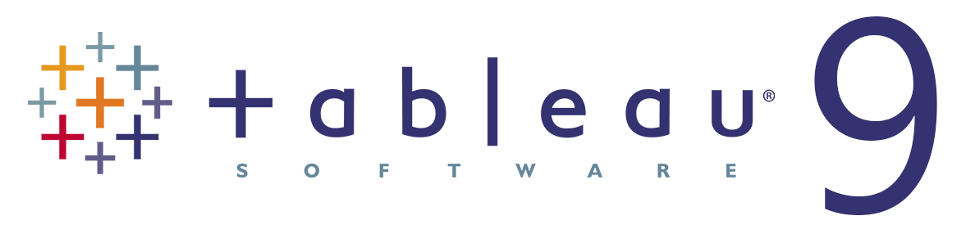
Project Process
Data Source
Washington Post
Twitter
Collection
BeautifulSoup
Tweepy
Analysis
Alchemy API
Text Sentiment
Manipulation
Visualization
Matplotlib
mySQL
Tableau

Slide 5
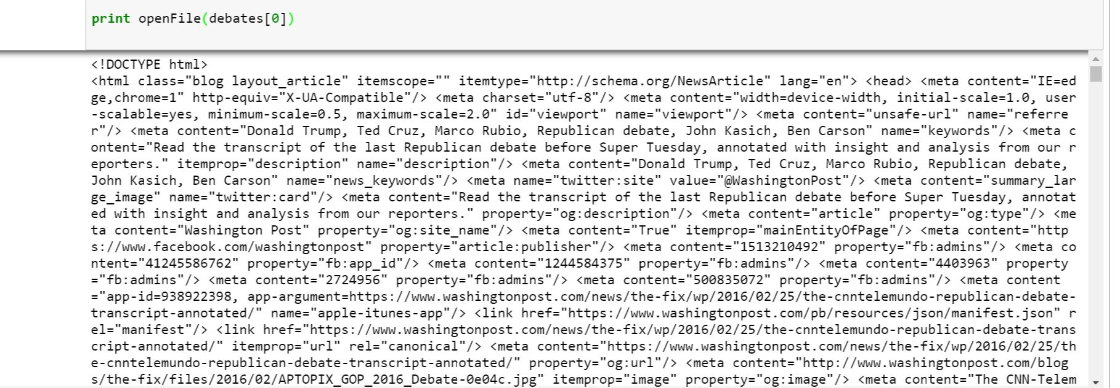
Difficulties
Washington Post
Parsing html
Determining who said what
Removing punctuation
Twitter
Tweepy
429 Overload
Geocode & User Location – user enabled
3200 tweets max per unique query
Topsy
Shut down – 10 days max twitter history
Sentiment Analysis
Throttle error
Traceback (most recent call last): File “extract_test.py”, line 43, in response=br.open(v) File “”/usr/local/lib/python2.7/dist-packages/mechanize/_mechanize.py” line 203, in open return self._mech_open(url, data, timeout=timeout) File “/usrlocal/lib/python2.7/dist-packages/mechanize/_mechanize.py”, line 255, in _mech_open raise response mechanize._response.httperror_seek_wrapper: HTTP Error 429: Unknown Response Code
Notes:
1800 tweets in 15 minutes
200 queries within 1 loop 40 second sleep mode * 16 loops = 3200 tweets max
Sentiment analysis - : only run limited number of sentiments at a time in api

Slide 6
Agenda
Project Process
What Do the Debates Say?
Public Sentiment
Conclusion

Slide 7
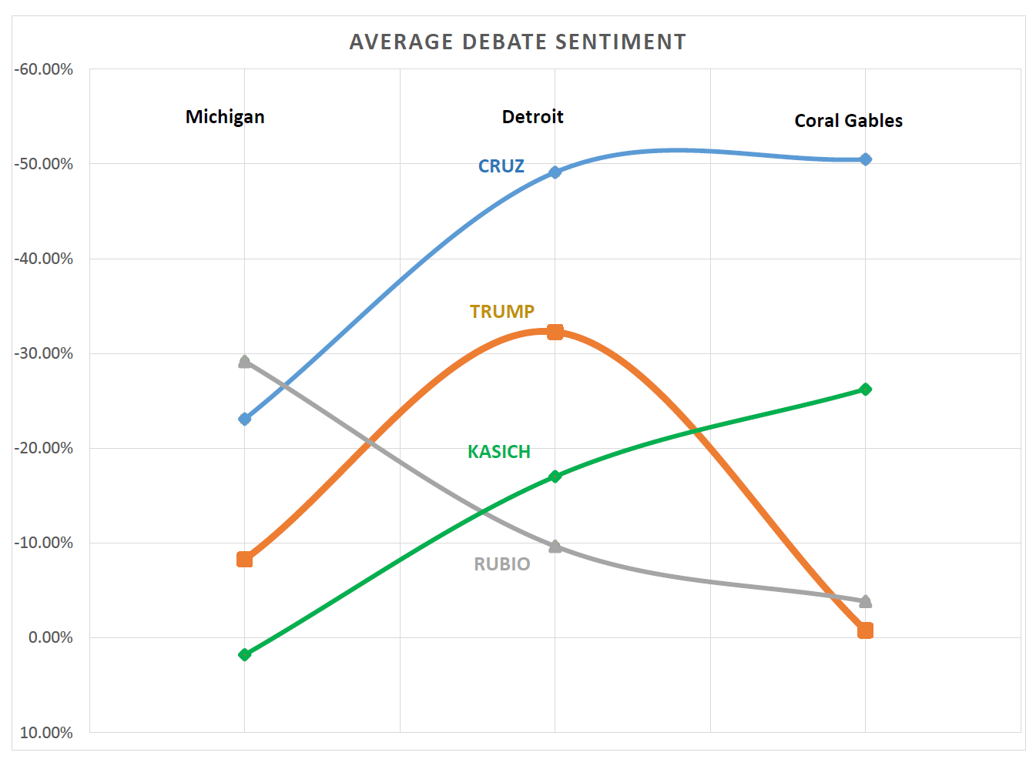
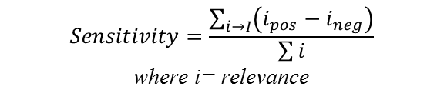
What do the debates say?
$$Sensitivity=\frac{\sum_{i→I}{\left(i_{pos}−i_{neg}\right)}}{\sum{i}}$$
where i= relevance
Cruz and Kasich get more negative as they get desperate.
Trump has an outlier negative performance in Detroit
Rubio continues to be neutral

Slide 8
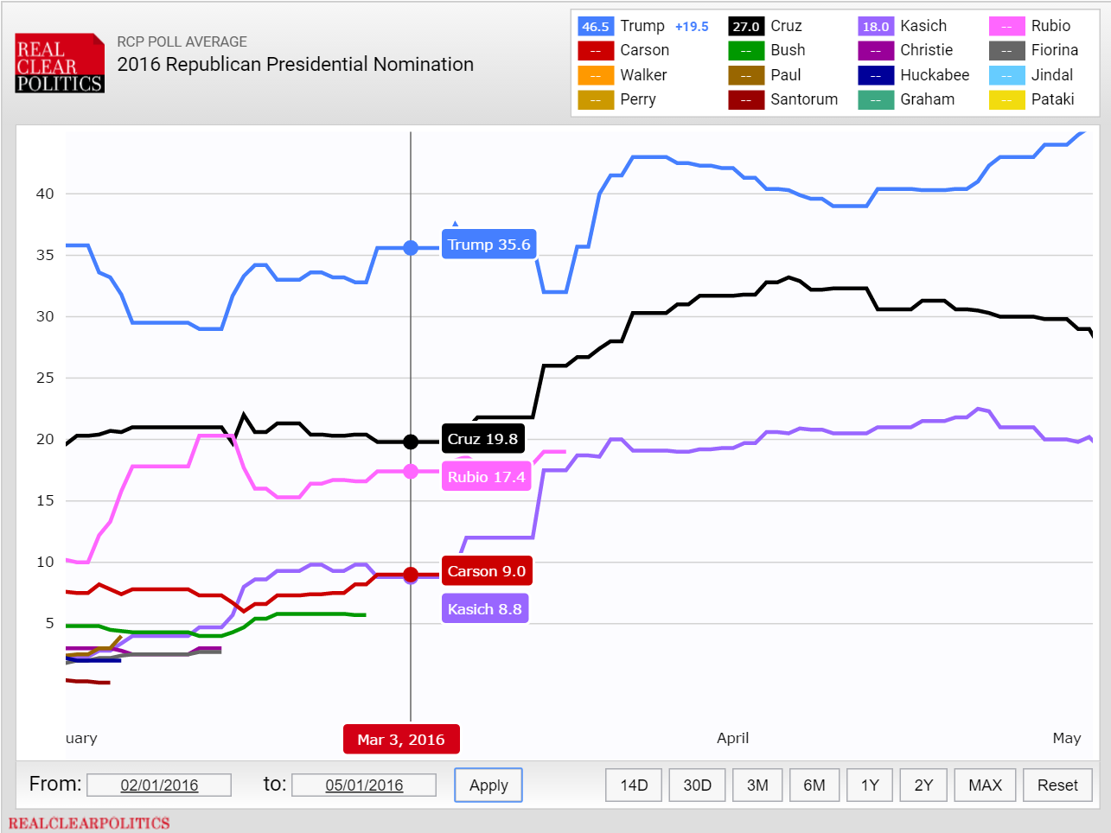



What happened in Detroit?
NEWS HEADLINES
“Trump was attention of attacks at GOP debate”
“Taking On Donald Trump, at Their Own Peril”
“Watch every time FOX News attacked Trump at GOP debate.”

Slide 9
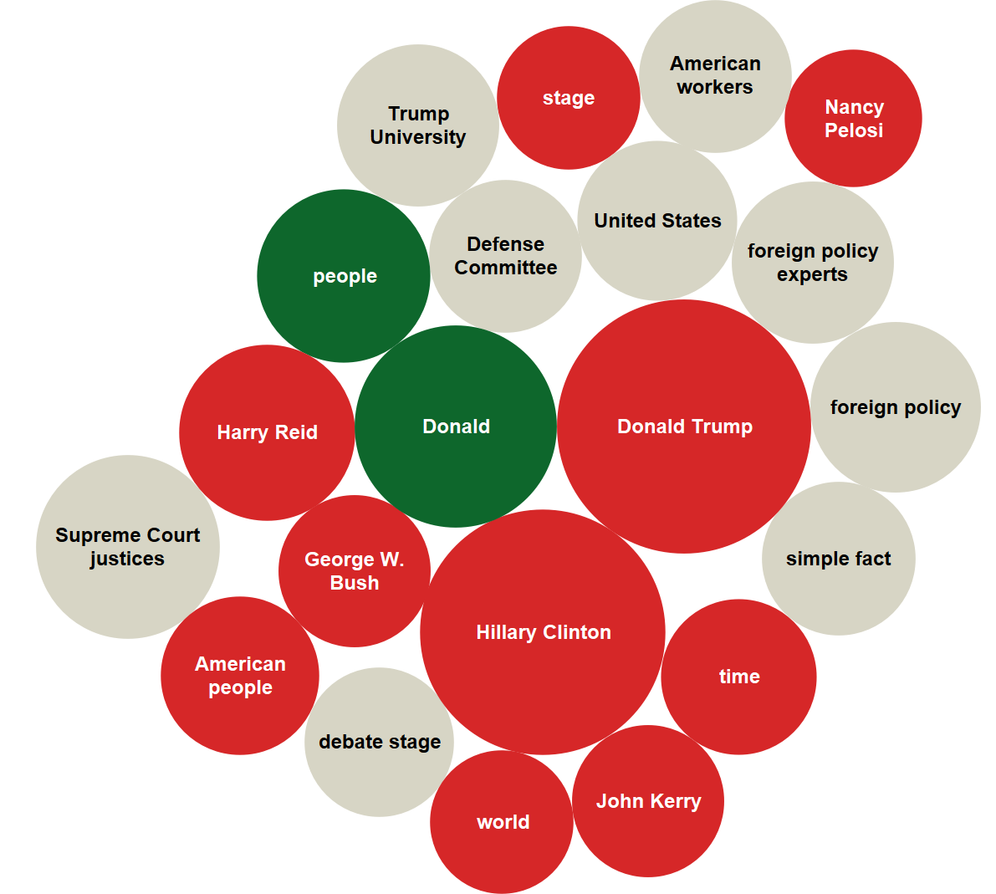
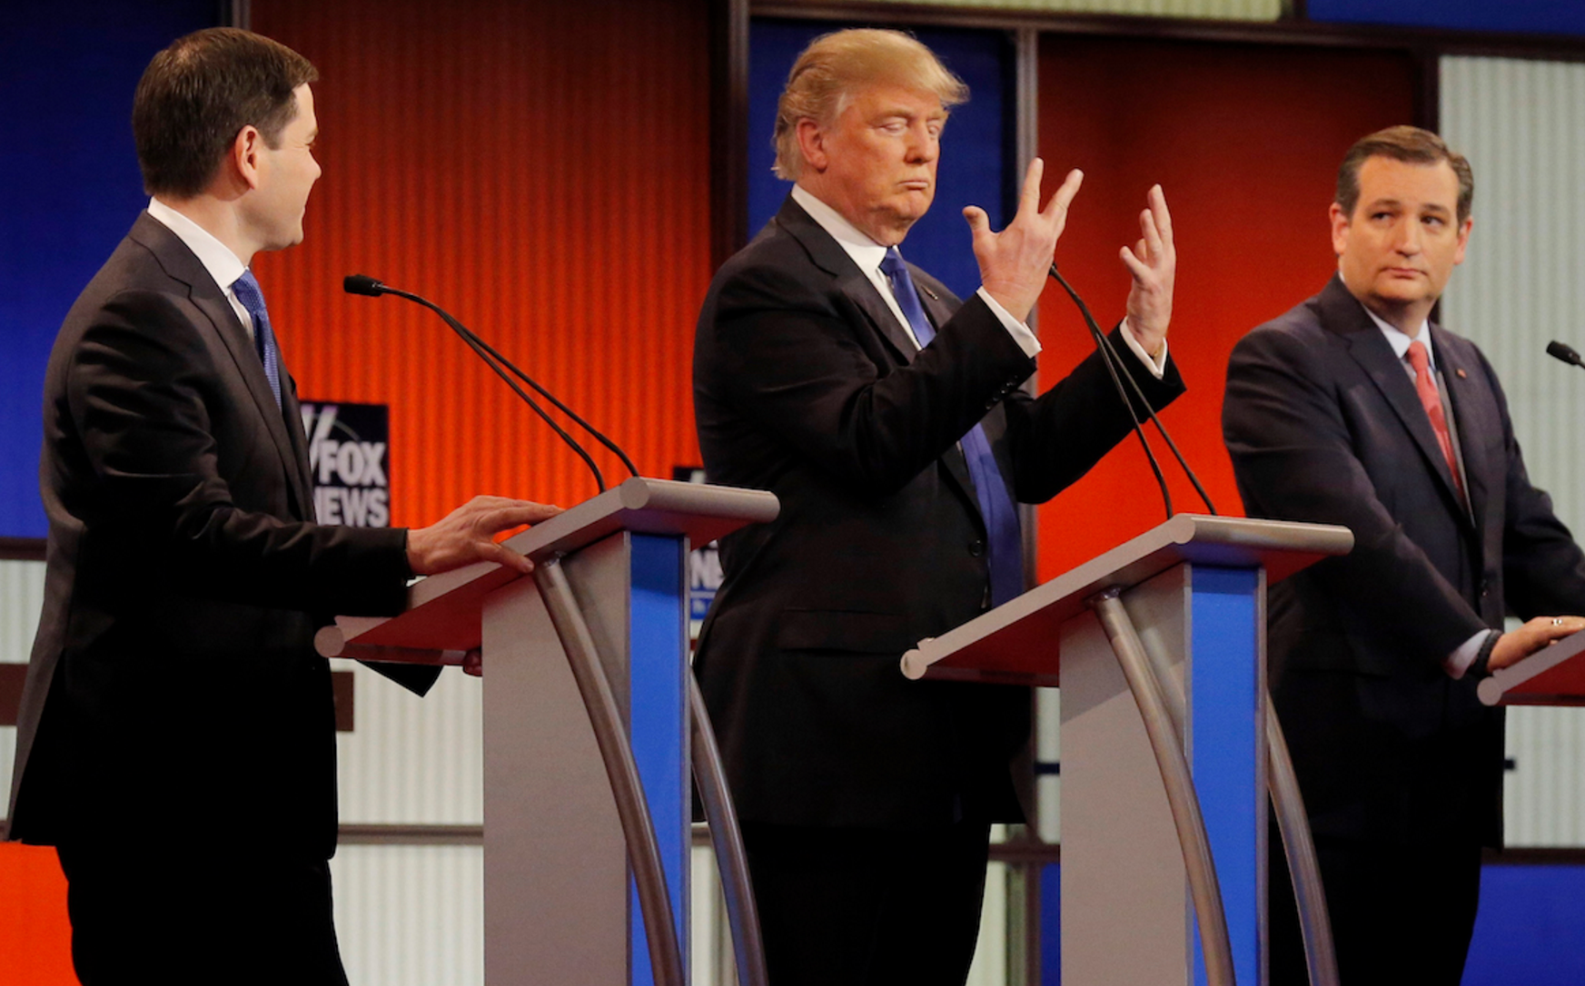
What happened in Detroit?
Trump proving he doesn’t have small hands

Slide 10
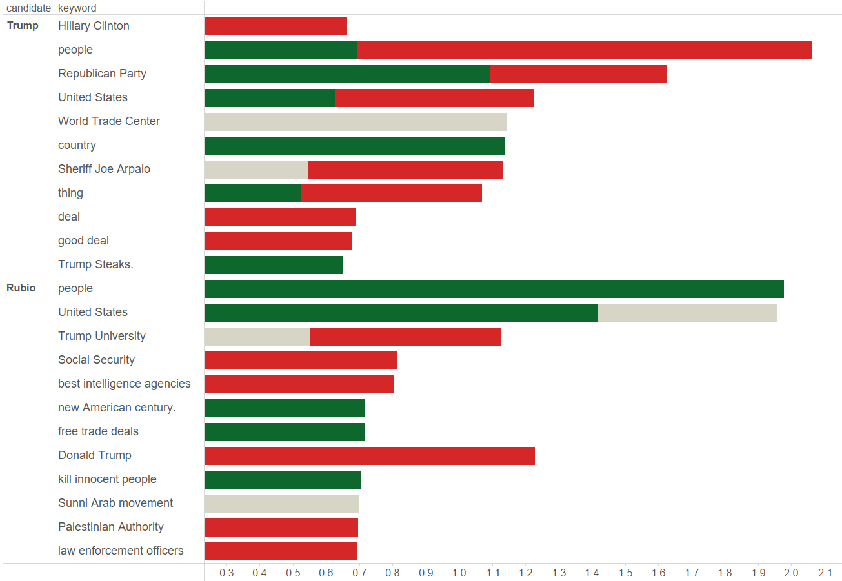
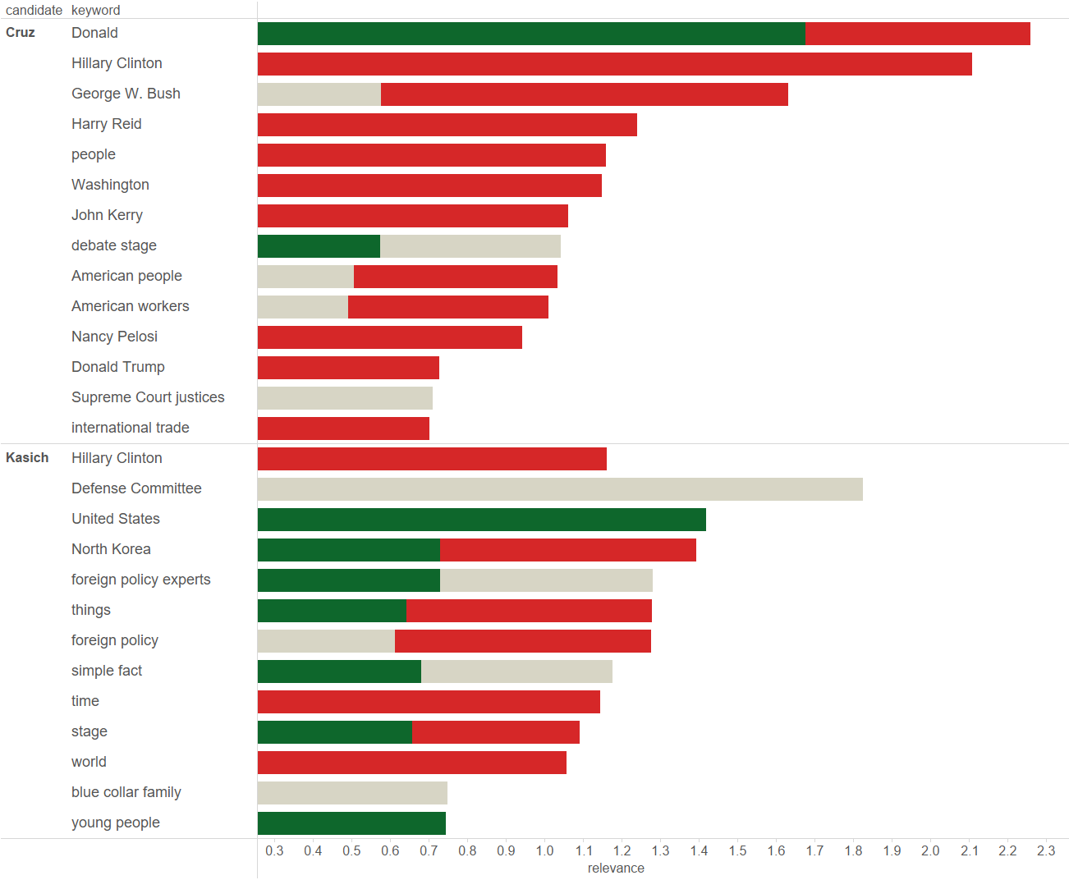
Key Topics Through 3 Debates

Slide 11
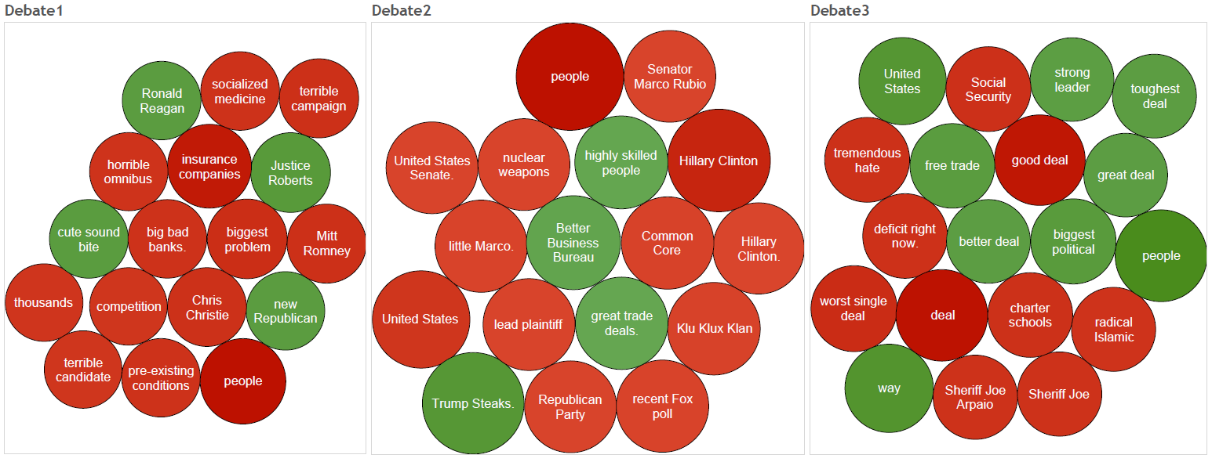
Trump Main Focus
Common theme of the people not being happy.
Denouncing government veterans and current GOP establishment.

Slide 12
Agenda
Project Process
What Do the Debates Say?
Public Sentiment
Conclusion

Slide 13

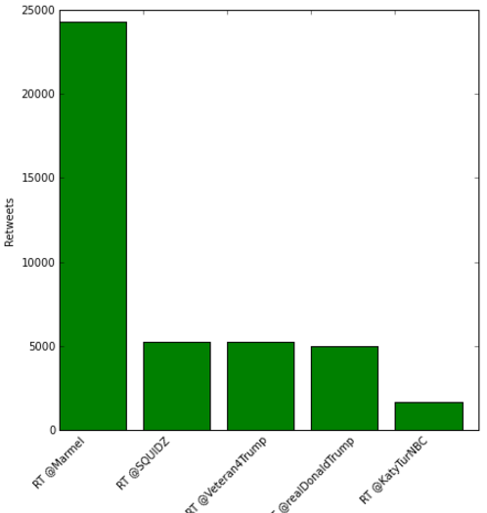
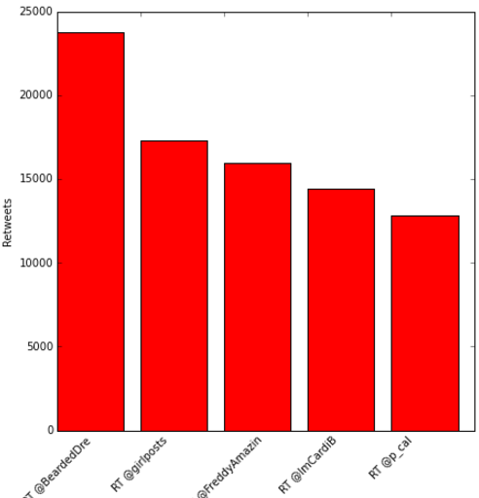
Trump: Top 5 Negative and Positive Tweets
POSITIVE
1 | Whoever made this Trump v. Manson. http://t.co/ztUx36aY1c
2 | Mexicans and Black People teaming up against Donald Trump BOY LIFE BEAUTIFUL RN MY NIGGA
3 | I’m a Veteran. I was born in Mexico
4 | Thank you Wilkes-Barre #MakeAmericaGreatAgain #Trump2016 https://t.co/FJbNlidwJF
5 | Wilkes Barre
NEGATIVE
1 | I pray and I pray trump doesn’t get elected VOTE…
2 | Me: green is like the ugliest color ever Donald trump: I hate the color green Me: https://t.co/ryJcjKm8B1
3 | I’M SCREAMING THEY DROVE PAST A TRUMP RALLY AND PLAYED THIS https://t.co/gZAnYw1sXs
4 | Donald trump gona deport all the foreign bitches that yall love fucking
5 | Donald Trump rally vs Bernie Sanders rally

Slide 14
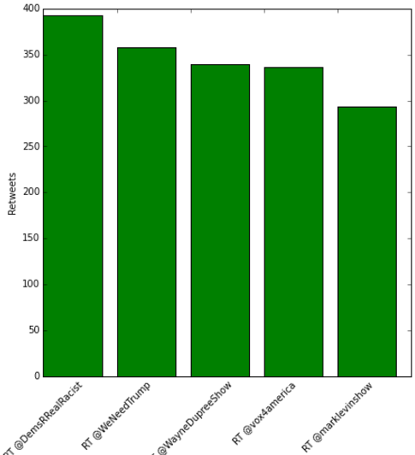
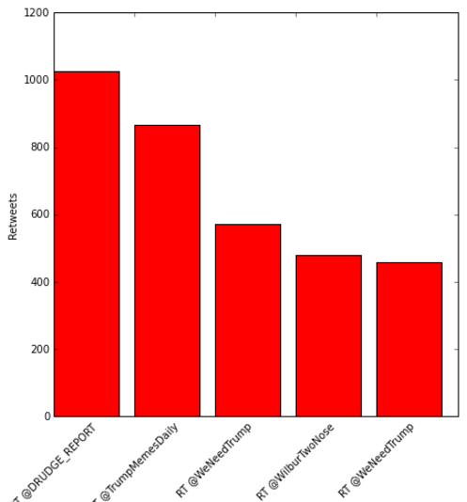
Cruz: Top 5 Negative and Positive Tweets
POSITIVE
1 | Ted Cruz understands that step number one is defeating that nasty Washington cartel is owing your electoral successes…
2 | Cruz
3 | Now do you believe me that the Cruz campaign is struggling #TrumpTrain #trump…
4 | On behalf of Trump supporters
5 | Sellout? Nah
NEGATIVE
1 | CRUZ CONFRONTED: HOW CAN YOU HAVE DELEGATES WITHOUT A VOTE? https://t.co/iUejLichH
2 | Cruz and Kasich should just drop out already #Trump2016 #VoteTrump #InPrimary #MakeAmericaGreatAgain
3 | Ithe people aren’t happy with the dirty politics Cru is playing. It’s over
4 | Cruz on CNN just said
5 | RETWEET if you think Cruz and Kasich’s attempt to subvert the popular vote is pathetic! #Trump2016

Slide 15
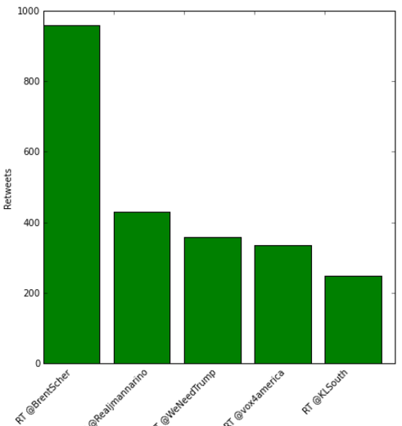
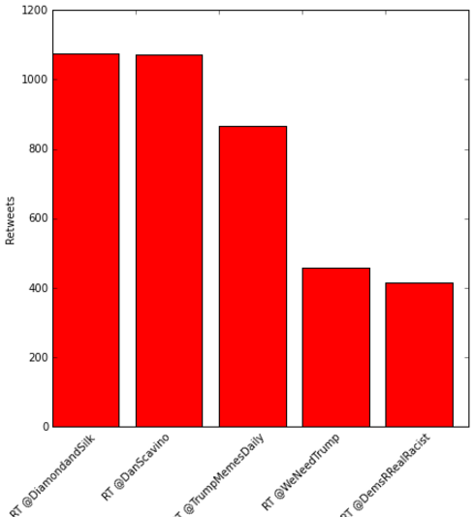
Kasich: Top 5 Negative and Positive Tweets
POSITIVE
1 | Am I crazy Kasic
2 | RETWEET THIS POLL SO WE CAN GET A BIG PICTURE IDEA! Cruz and Kasich teaming up makes me…
3 | Cruz Kasic
4 | On behalf of Trump supporters Kasich
5 | #Cruz #Kasich are publicly confessing they’re nothing more than spoilers on behalf of the Establishment – as #Trump expands hi…
NEGATIVE
1 | Lyin’ Ted &amp; Lunatic Kasich it will be a cold day inside of a Volcano before @DiamondandSilk vote for either of you.
2 | Should say: Follow taking points in Kasich deal. WE ARE LOSING &amp; WE ARE DESPERATE! Don’t let them see you sweat!
3 | Cruz and Kasich shoul djust drop out drop out already #Trump2016 #VoteTrump #INPrimary #MakeAmericaGreatAgain https://…
4 | RETWEET if you think Cruz and Kasich’s attempt to subvert the popular vote is pathetic! #Trump2016
5 | Attention Cruz and Kasich supporters: read your e-mail CAREFULLY so you don’t get confused about who they say you have…

Slide 16
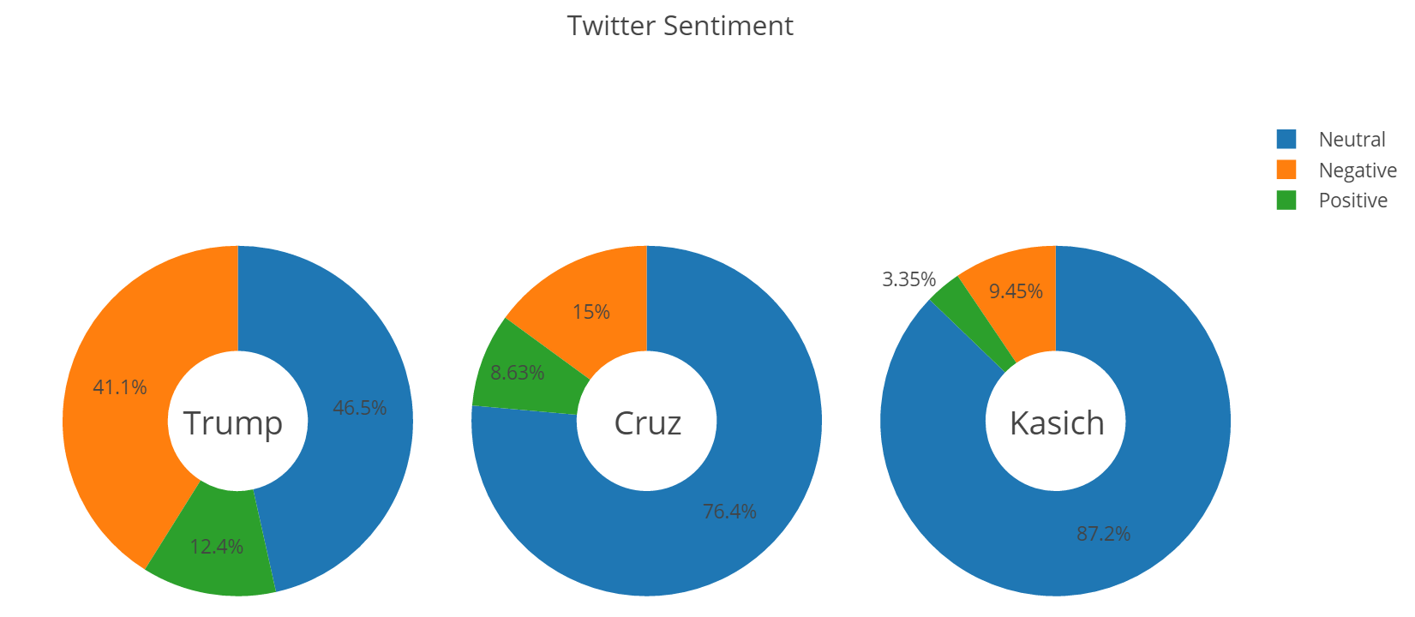
Trump Wins the Popularity Vote
Although all candidates’ tweets have similar sentiment profiles, Trump wins due to the sheer volume of tweets about him

Slide 17
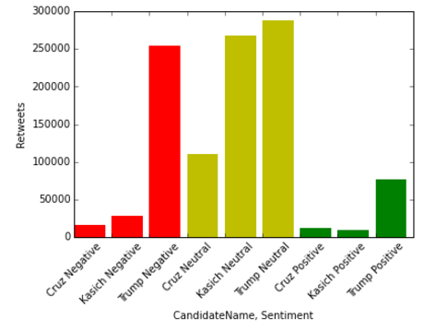
Candidate Sentiment by Volume

Slide 18
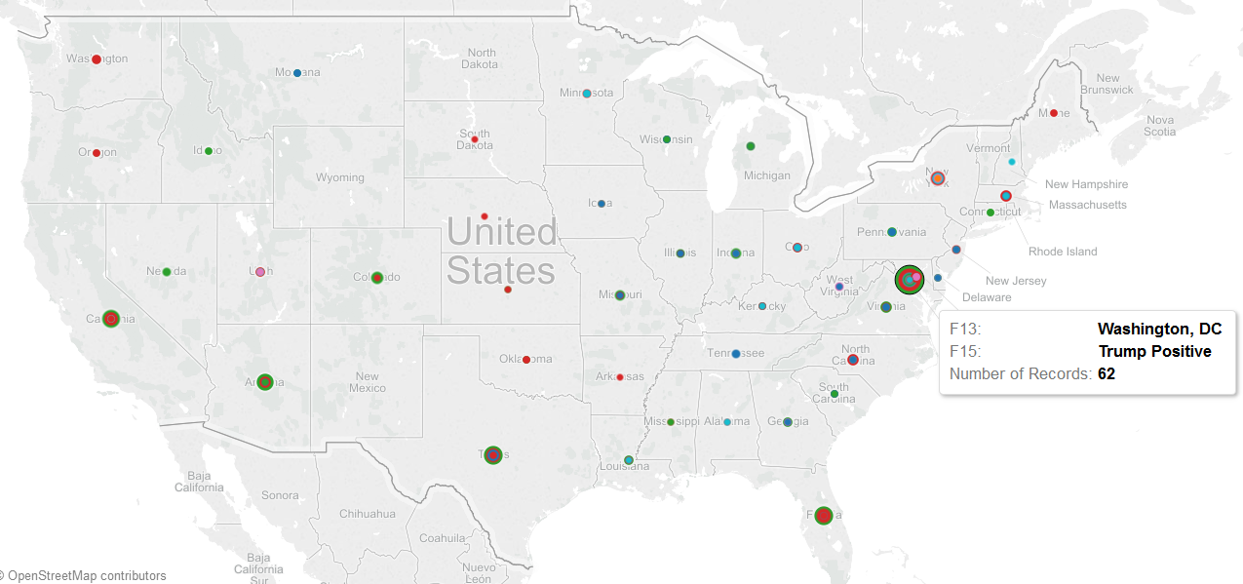
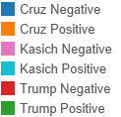
Candidate Tweets by Map

Slide 19
Agenda
Project Process
What Do the Debates Say?
Public Sentiment
Conclusion

Slide 20
Conclusion
Our hypothesis erred on two key aspects
Assumption: Trump most negative debate sentiment
Assumption: Trump most positive social media support
Ultimately, Trump’s debate sentiment improved over the course of the debates while his primary challenges Cruz and Kasich grew more negative
Trump generated the most social media, but also accounted for the most negative social media due to heightened general scrutiny of controversial comments

Slide 21
Additional Questions
Our approach yielded additional research opportunities:
Using Twitter sentiment analysis and location data of tweets, examine correlation between change in tweet sentiment pre/post-debate and whether debate sentiment had an impact on polling data relative to state primary results
For the debates between Donald Trump and the democratic candidate, apply a similar analysis over several debates to chart the impact of debate sentiment for a more constrained data sample

Slide 22
Thank You
Thank you for your attention. We welcome any comments or questions on our project.
Sincerely,
Janul, Ankur, Christina, & Peter

Slide 23
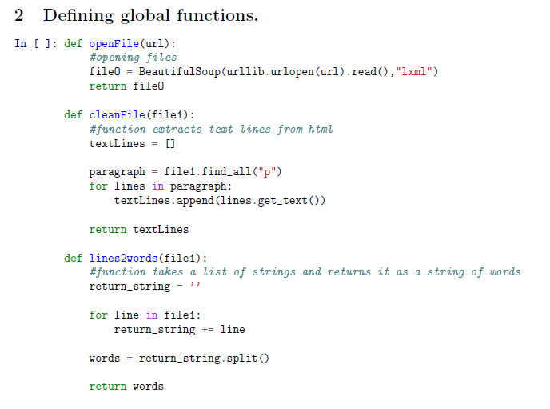
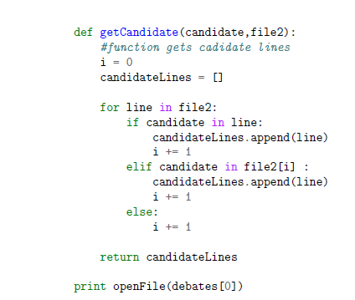
Appendix

Slide 24
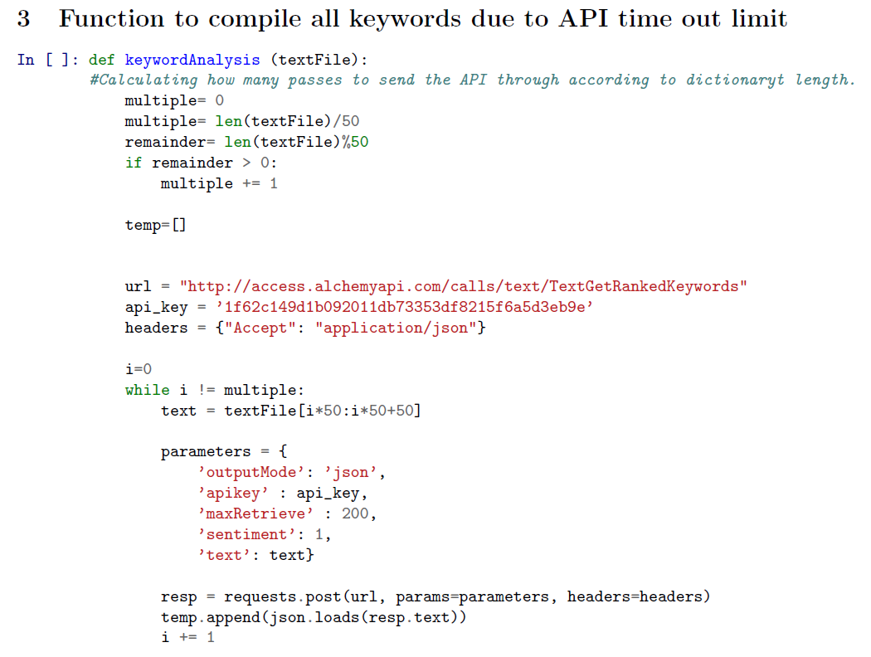
Appendix

Slide 25
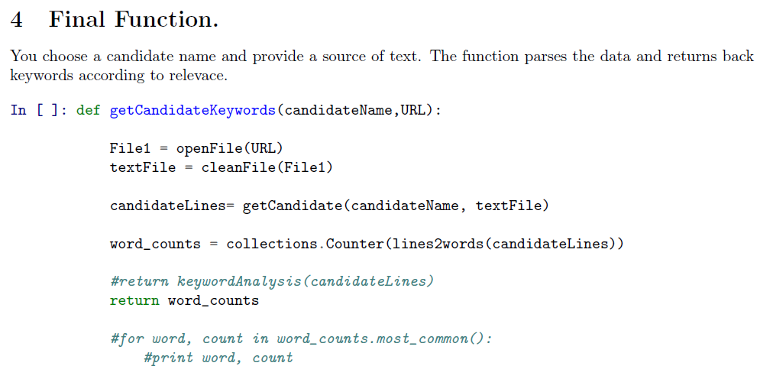
Appendix

Slide 26
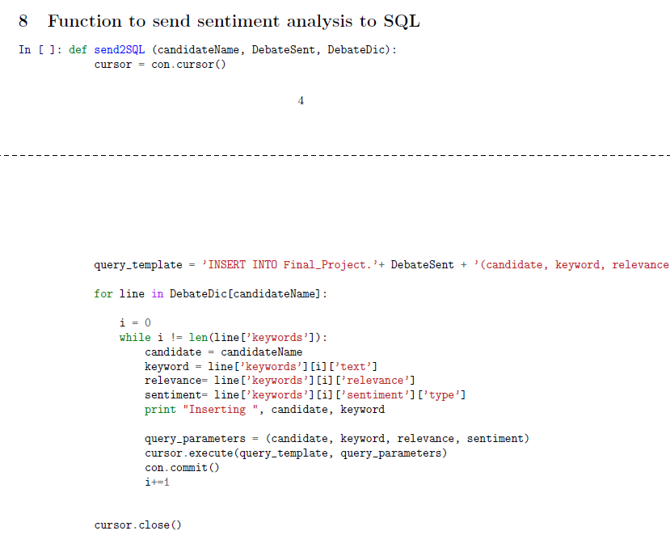
Appendix

Slide 27
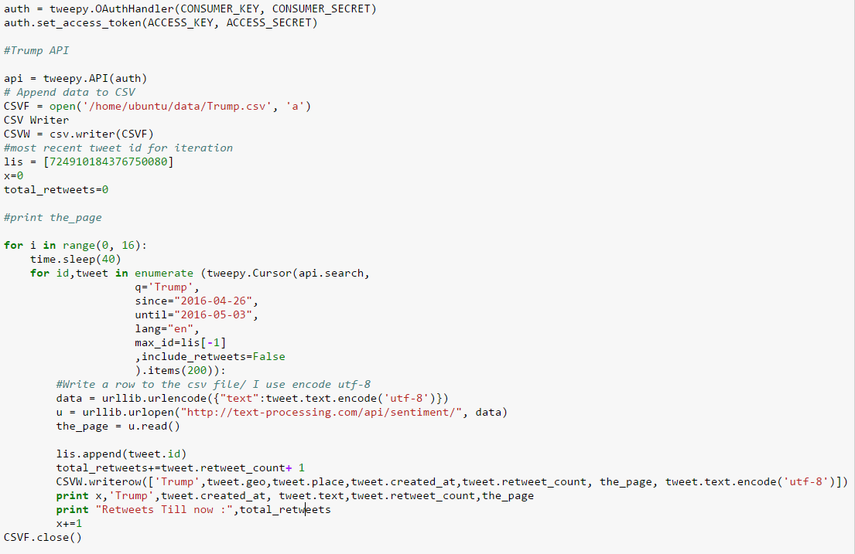
Appendix
Inserting data into CSV via Tweepy and running Sentiment classifier over it

Slide 28
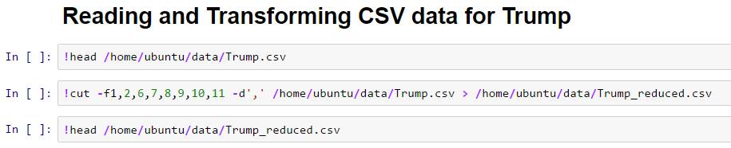
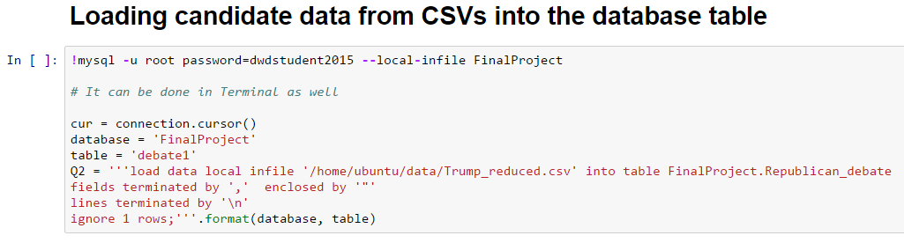
Appendix

Slide 29
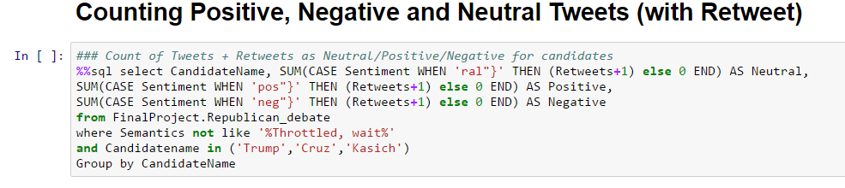
Appendix

